Slide 1
Nov 2024
LASSO App development
Creating a Matlab App with an integrated AI Chatbot
Andrew Young

Slide 2
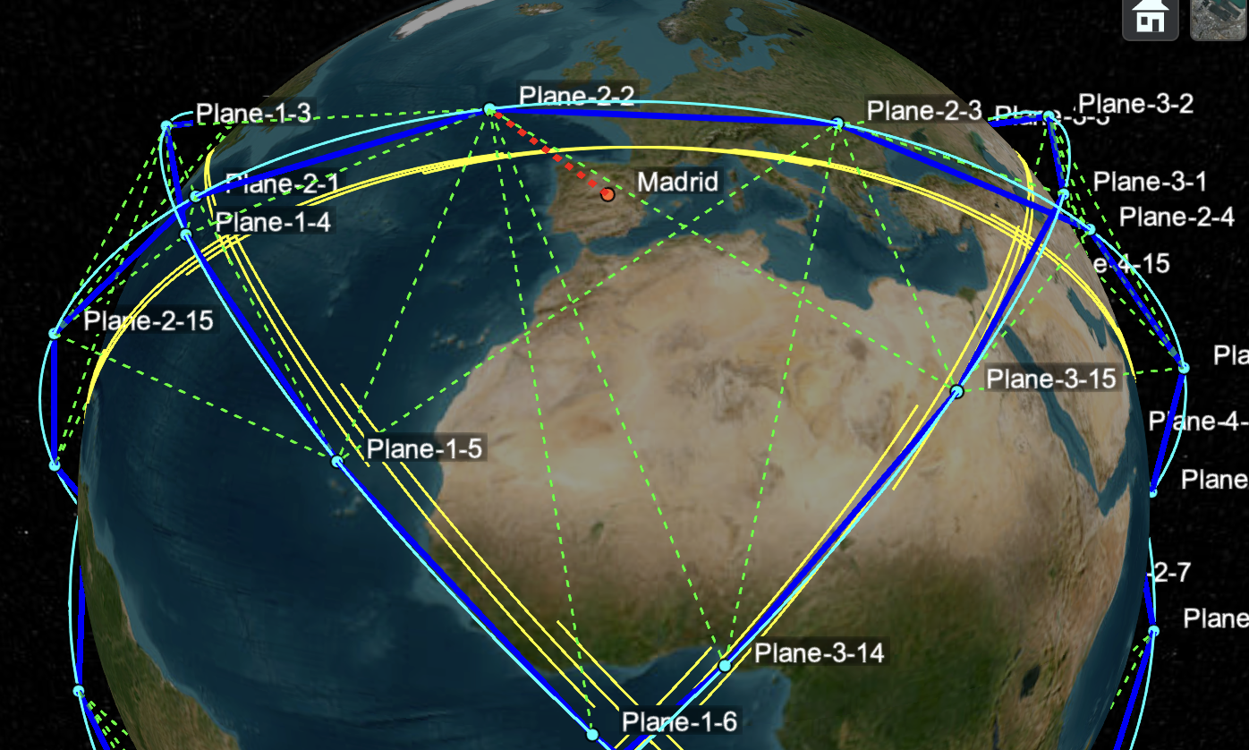
Project Background
American Geophysical Union (AGU)
Michael H. Freilich Student Visualization Project
Present innovative methods for visualizing data
Demonstrate cross-discipline collaboration
Enhanced capabilities of previously completed RedStone Project
Visualize satellite constellations and their communications

Slide 3
App Goals
Simplify process for designing constellations for specific mission purposes
Integrate ChatGPT as an AI Assistant to provide user guidance
Provide educational experience and usability for technical and non-technical users

Slide 4
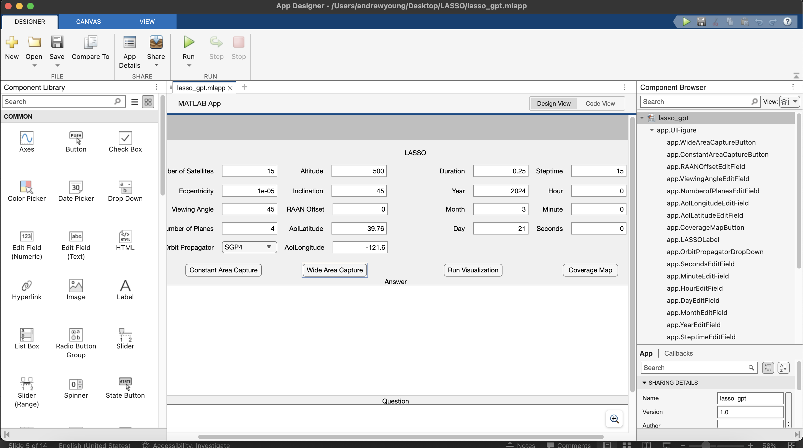
MATLAB App Designer
Provided cohesive framework for app interface
Drag-and-drop functionality used for input fields and UI components
Refactor scripts into functions that take user input and are called by button pushes

Slide 5
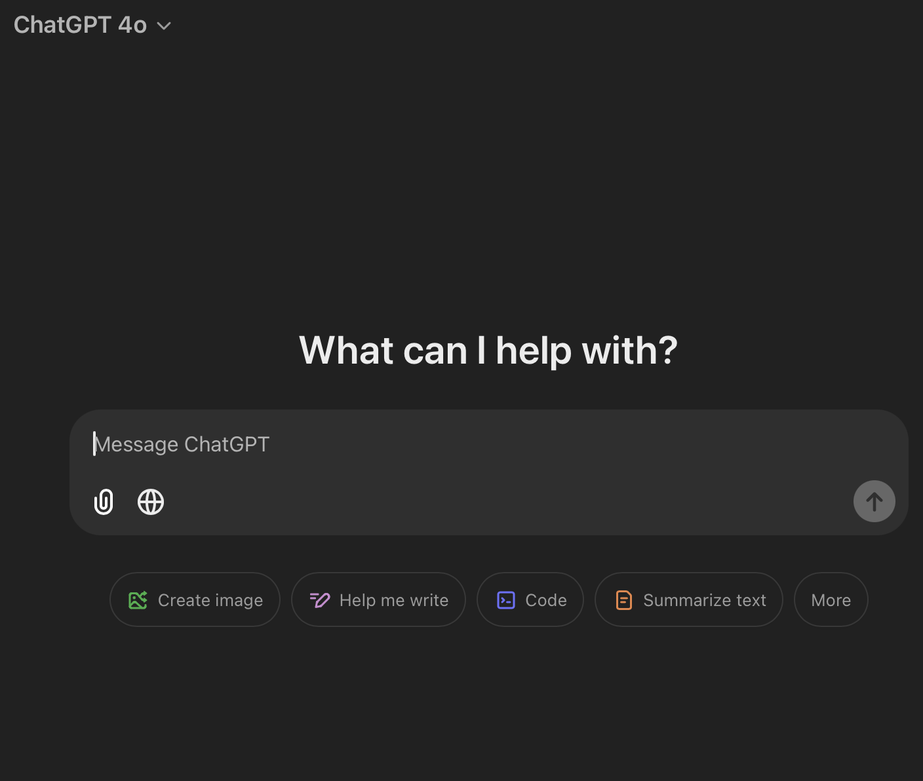
Large Language Models (LLMs)
AI Assistant, LASSO_GPT, is powered by ChatGPT
Trained on vast amounts of text data, learning patterns and language structure
Uses transformer architecture to manage context and language dependencies
Enables the model to generate coherent, context-aware responses

Slide 6
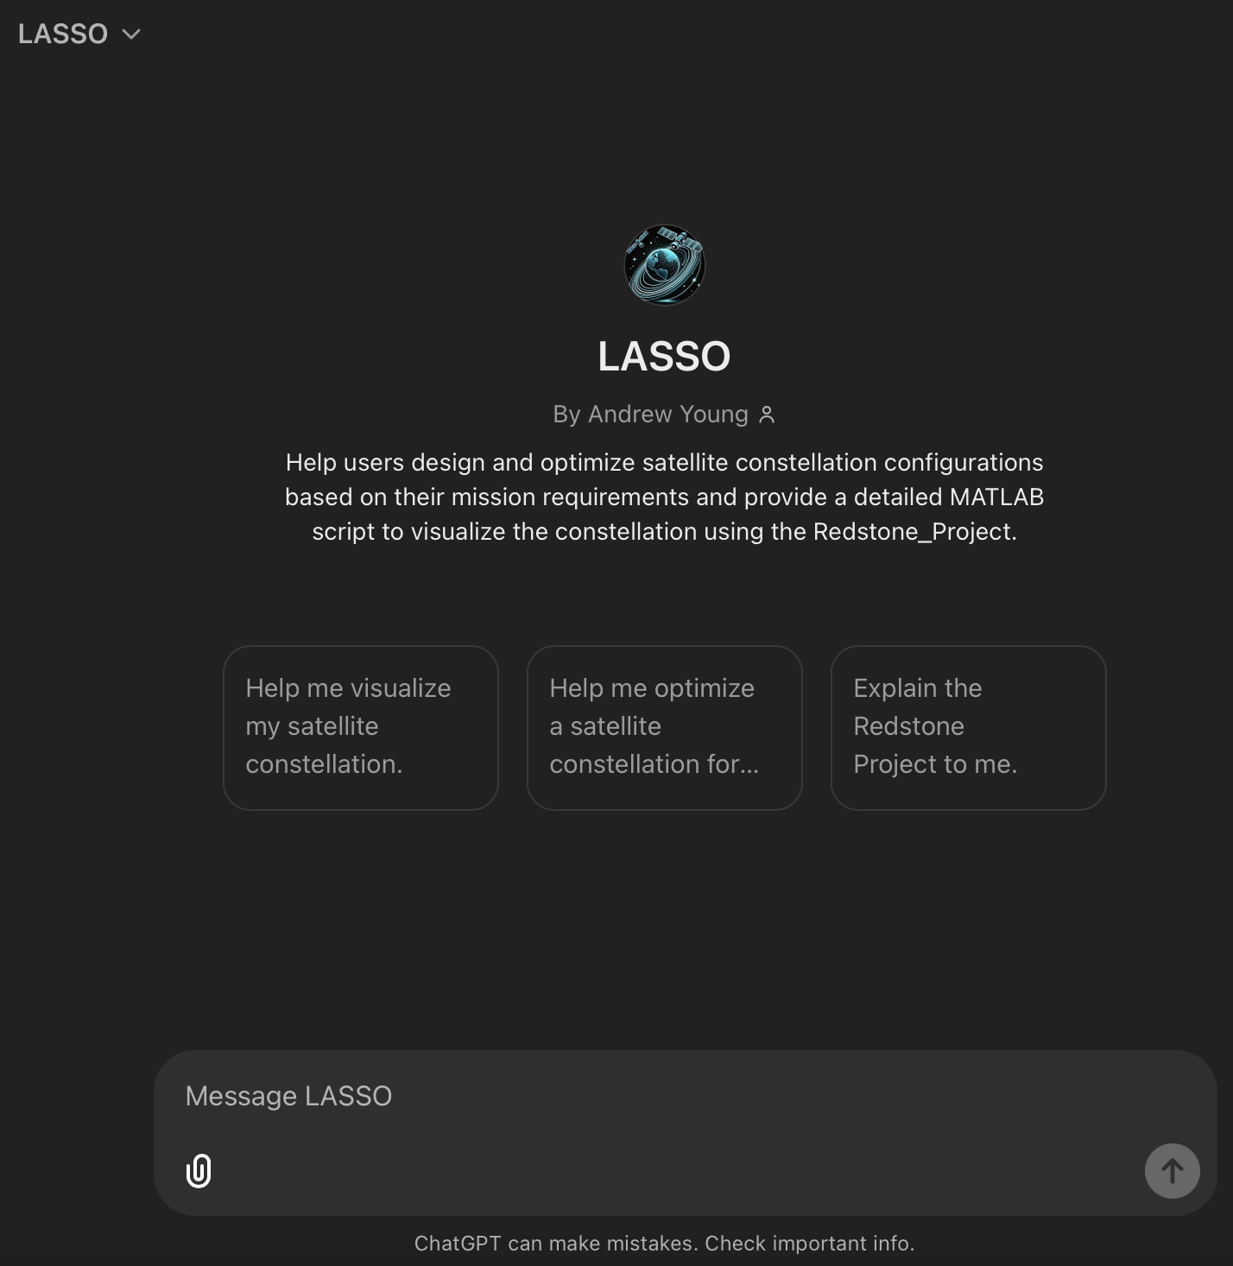
TEXAS AEROSPACE ENGINEERING AND ENGINEERING MECHANICS
Custom GPT vs Assistant API
CustomGPT
Upload documents to tailor model to specific tasks
No code development needed
Can share link with other users
Comes with ChatGPT Plus subscription
Assistant API
Allows access to tailored model from external apps
Charged by amount of used
Notes:
Moxi’s primary function is to take care of smaller routine tasks that allow nurses and other health care workers put even more focus on patients.
The startup works with hospitals to train Moxi to perform tasks and learn its way around a facility
In the future, Diligent Robotics wants Moxi to be able to quickly learn new tasks, so it can adapt to hospital needs on the fly.

Slide 7
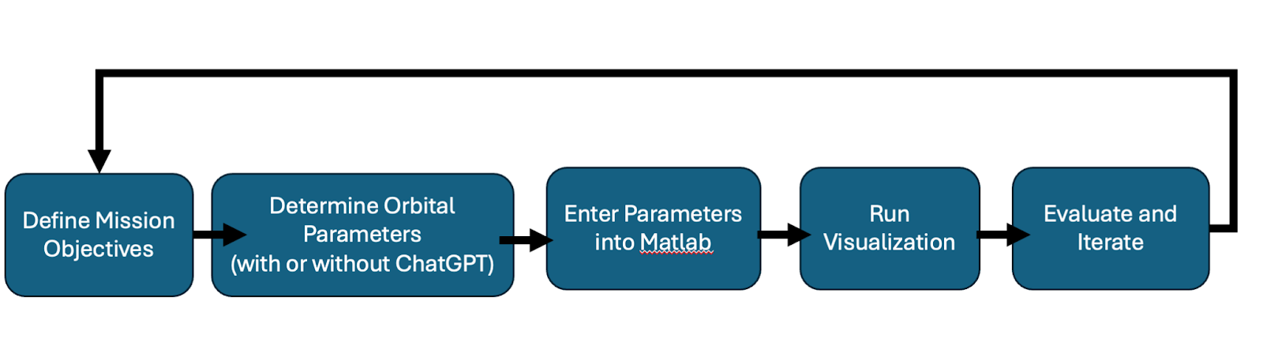
TEXAS AEROSPACE ENGINEERING AND ENGINEERING MECHANICS
User Flow
Notes:
Moxi’s primary function is to take care of smaller routine tasks that allow nurses and other health care workers put even more focus on patients.
The startup works with hospitals to train Moxi to perform tasks and learn its way around a facility
In the future, Diligent Robotics wants Moxi to be able to quickly learn new tasks, so it can adapt to hospital needs on the fly.

Slide 8
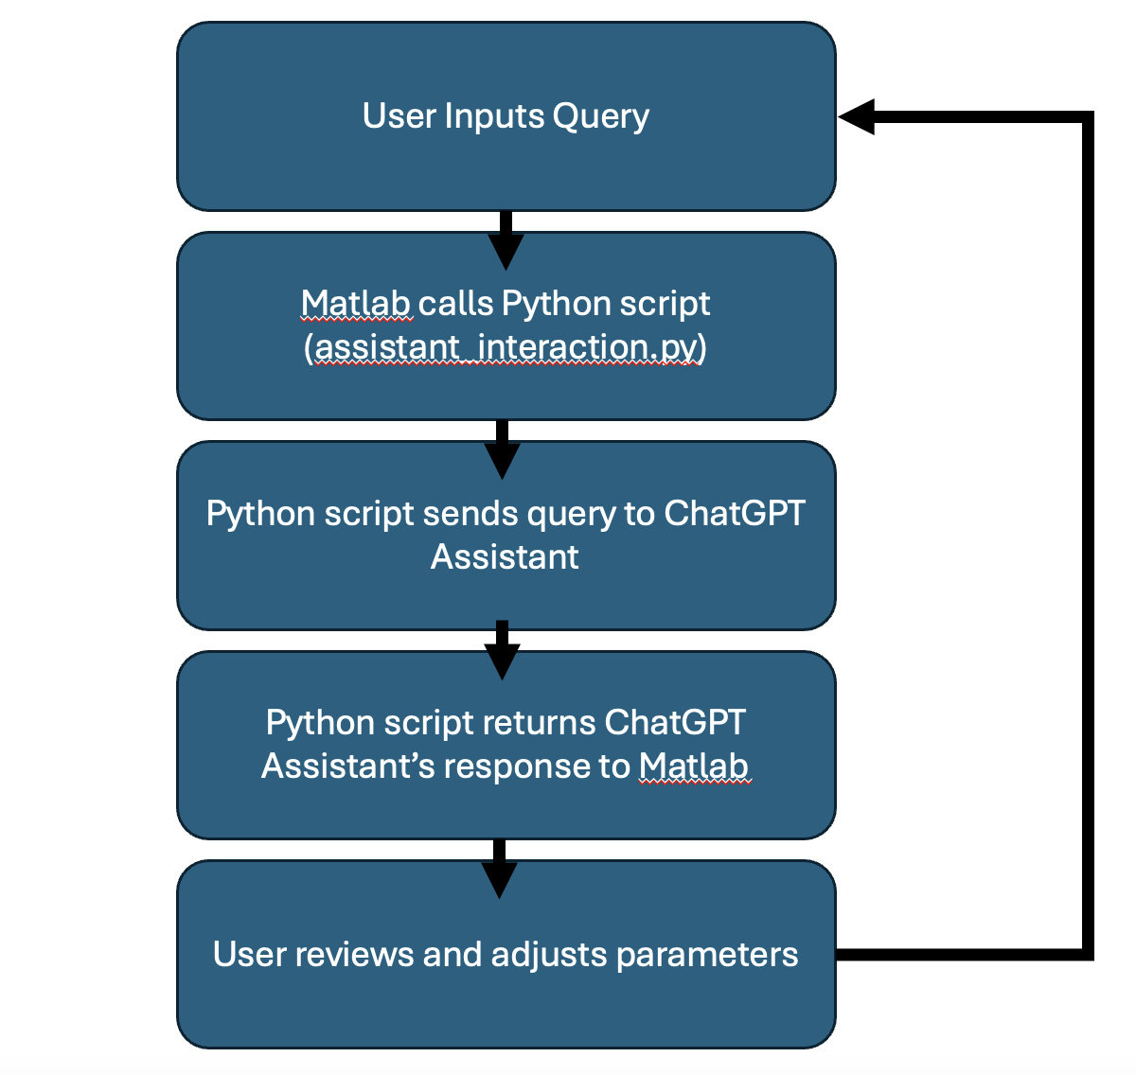
TEXAS AEROSPACE ENGINEERING AND ENGINEERING MECHANICS
Data Flow
Notes:
Moxi’s primary function is to take care of smaller routine tasks that allow nurses and other health care workers put even more focus on patients.
The startup works with hospitals to train Moxi to perform tasks and learn its way around a facility
In the future, Diligent Robotics wants Moxi to be able to quickly learn new tasks, so it can adapt to hospital needs on the fly.

Slide 9
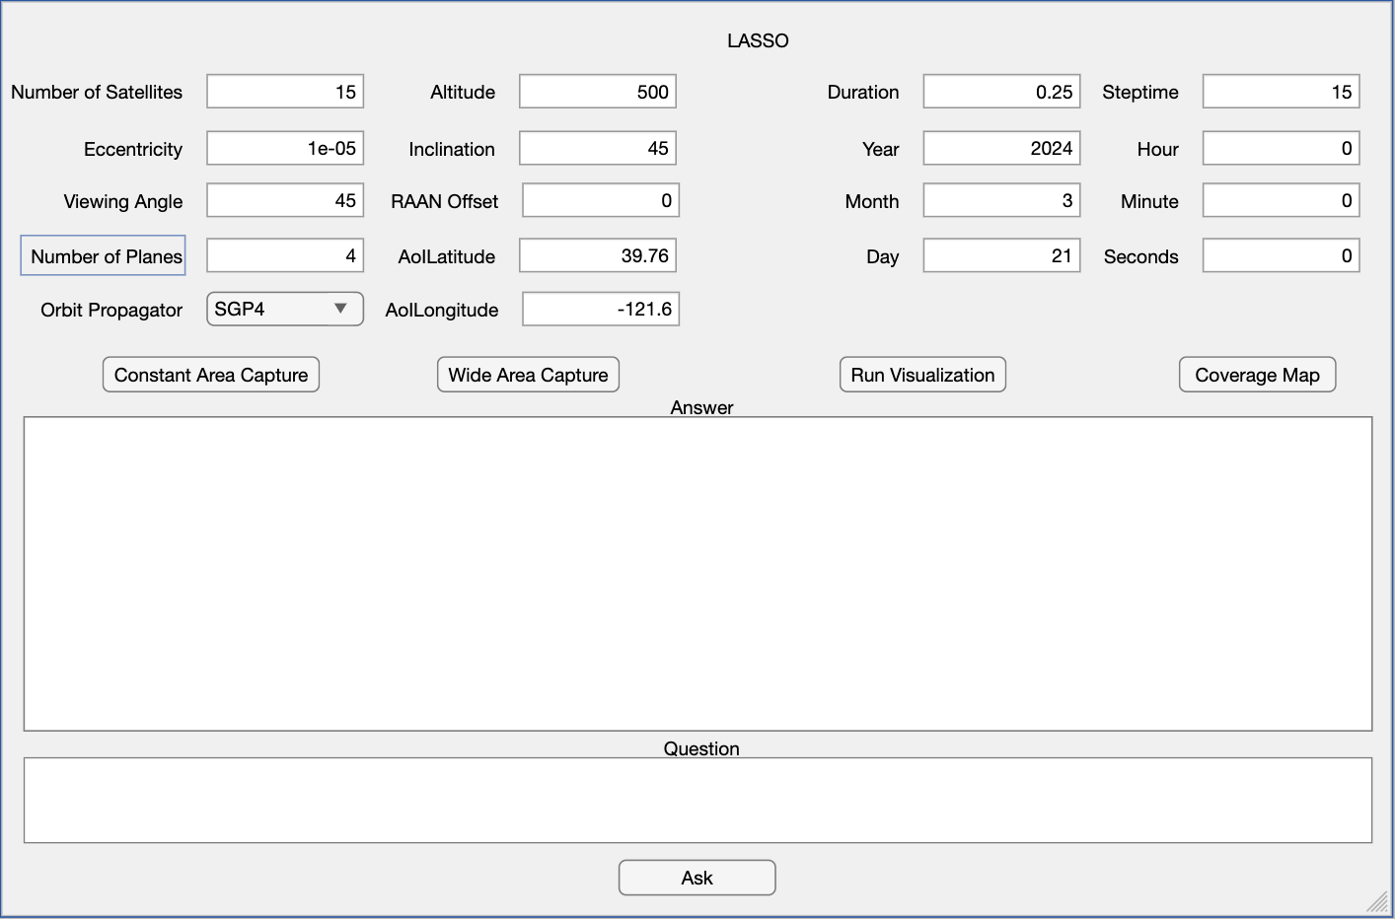
TEXAS AEROSPACE ENGINEERING AND ENGINEERING MECHANICS
App Features
Parameter Controls: Adjust inclination, altitude, RAAN, and other key parameters
Simulation Engine: Uses Matlab’s Satellite Communications Toolbox to calculate satellite positioning and coverage
Visualization: Shows satellite paths and ground tracks on a 3D model of Earth
AI Assistant: ChatGPT provides real-time feedback, explanations, and guidance for users
Notes:
Moxi’s primary function is to take care of smaller routine tasks that allow nurses and other health care workers put even more focus on patients.
The startup works with hospitals to train Moxi to perform tasks and learn its way around a facility
In the future, Diligent Robotics wants Moxi to be able to quickly learn new tasks, so it can adapt to hospital needs on the fly.

Slide 10
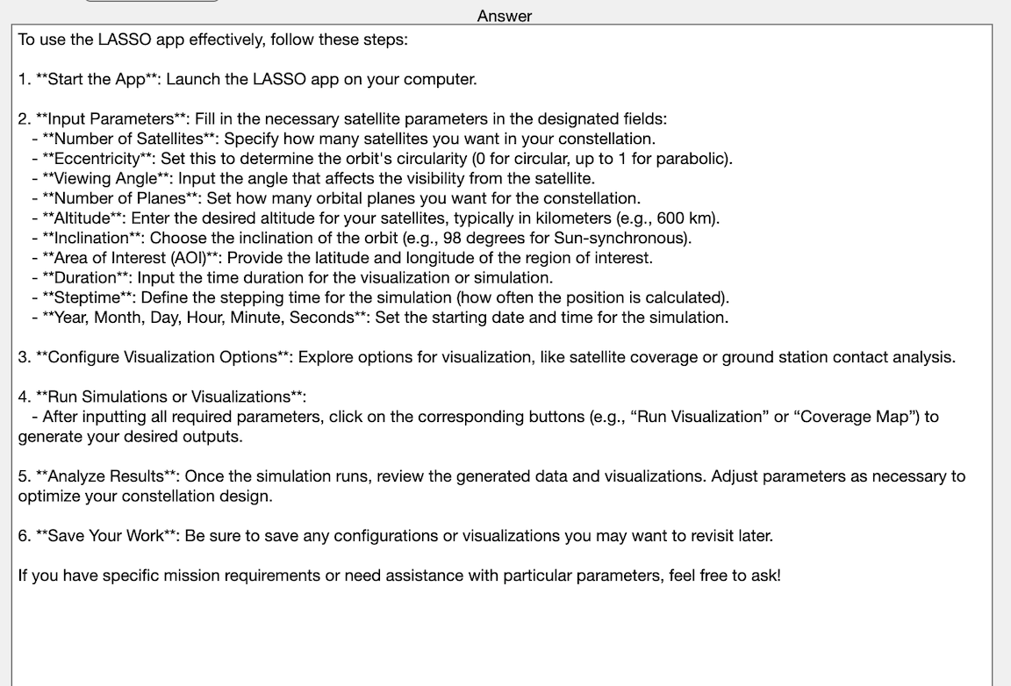
TEXAS AEROSPACE ENGINEERING AND ENGINEERING MECHANICS
Technical Issues
Challenges:
Readability of responses due to text formatting
Ensuring ChatGPT’s responses align with technical accuracy in orbital mechanics
Preventing users from using for random conversations
Solutions:
Implemented prompt engineering to improve response quality
Added filter in Matlab to remove unwanted extraneous characters
Added Spacecraft Dynamics textbook as additional training data
Notes:
Moxi’s primary function is to take care of smaller routine tasks that allow nurses and other health care workers put even more focus on patients.
The startup works with hospitals to train Moxi to perform tasks and learn its way around a facility
In the future, Diligent Robotics wants Moxi to be able to quickly learn new tasks, so it can adapt to hospital needs on the fly.

Slide 11
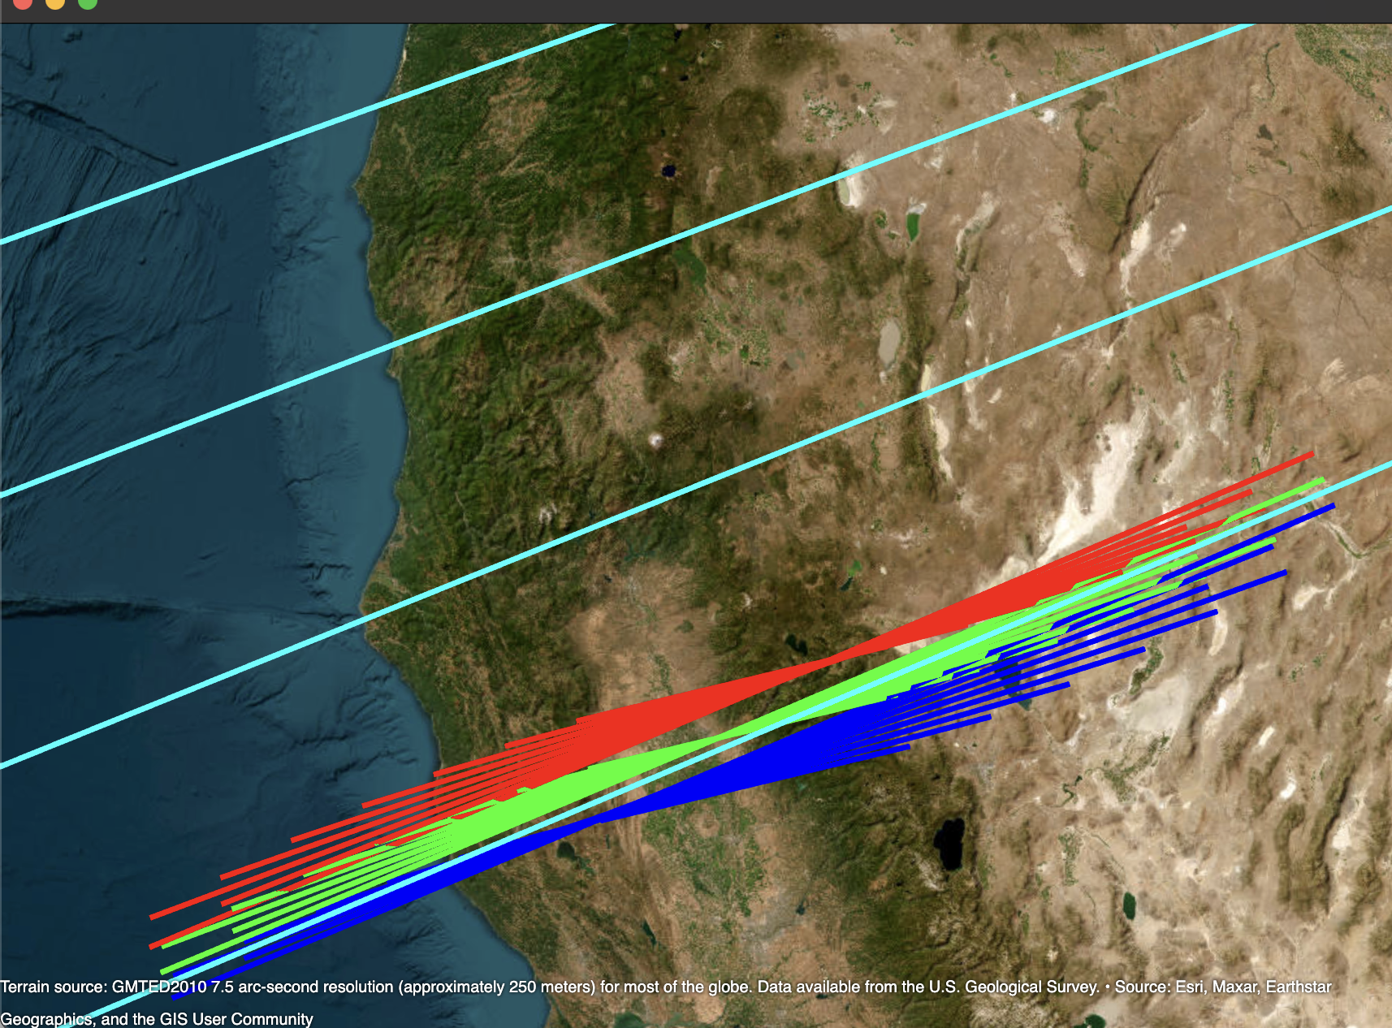
TEXAS AEROSPACE ENGINEERING AND ENGINEERING MECHANICS
Case Study
Wildfire Monitoring Example:
App can design a satellite constellation for wildfire monitoring (e.g., Paradise, CA)
Parameter adjustments achieve high revisit rates for real-time observation
ChatGPT Assistant explains parameter impacts on revisit frequency and resolution
Guides user toward optimal configurations for focused regional monitoring
Notes:
Moxi’s primary function is to take care of smaller routine tasks that allow nurses and other health care workers put even more focus on patients.
The startup works with hospitals to train Moxi to perform tasks and learn its way around a facility
In the future, Diligent Robotics wants Moxi to be able to quickly learn new tasks, so it can adapt to hospital needs on the fly.

Slide 12
TEXAS AEROSPACE ENGINEERING AND ENGINEERING MECHANICS
Future Work Ideas
Create an interactive environment with real-time parameter adjustments
Real-time simulation feedback for enhanced interactivity
Notes:
Moxi’s primary function is to take care of smaller routine tasks that allow nurses and other health care workers put even more focus on patients.
The startup works with hospitals to train Moxi to perform tasks and learn its way around a facility
In the future, Diligent Robotics wants Moxi to be able to quickly learn new tasks, so it can adapt to hospital needs on the fly.

Slide 13
Questions?
Andrew Young
Andrew.young778@utexas.edu

